Slide 1
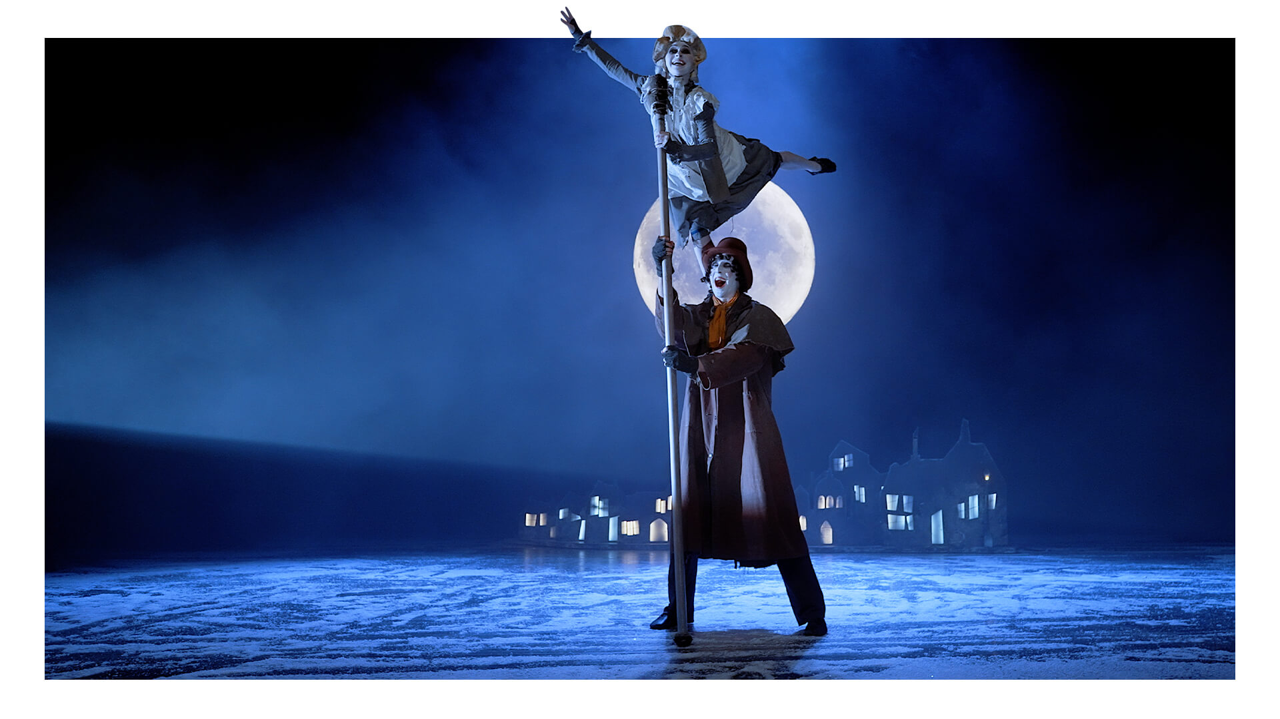
SMSC Focus
Lesson Objectives
To understand the meaning of cruelty and kindness
To recognise what cruelty, kindness and greed look like

Slide 2
z
Cruelty
Purposefully causing harm to others and not caring about it.
Kindness
Being friendly, charitable or caring.
Greed
A selfish need for power, money or food.

Slide 3
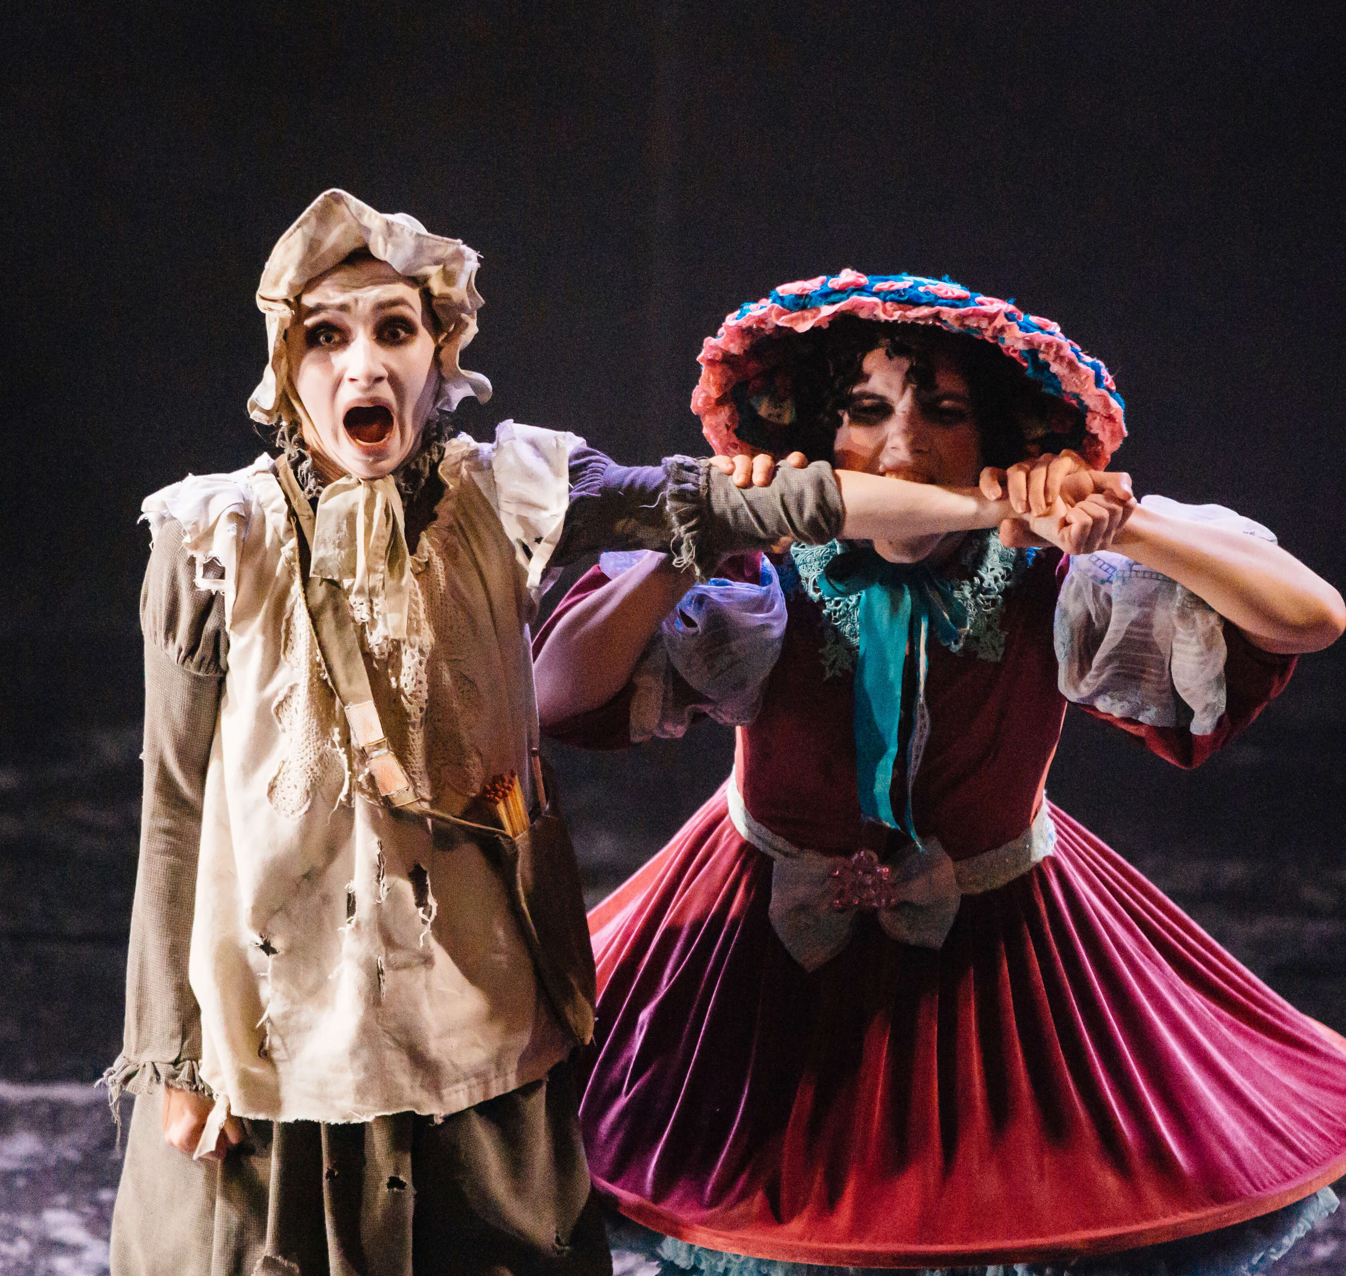
Cruelty
Watch the scene from 37:28 to 40:00.
In this scene, Angelica Maria chases the little match girl. She hits, pinches, kicks, bites her arm and scratches her. Angelica takes all of her matches and sets them alight. She skips off, leaving the little match girl cold and alone.

Slide 4
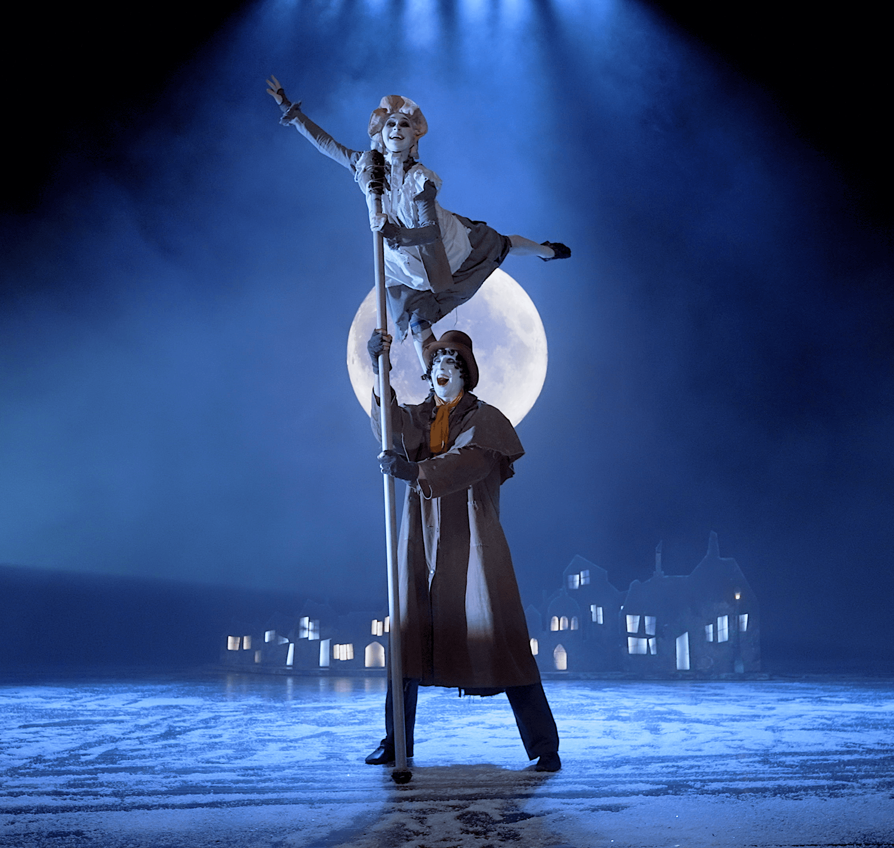
Kindness
Watch the scene from 08:10 to 12:57.
In this scene, Francesco the Lamplighter plays and dances with the little match girl. She uses one of her matches to help him light a street lamp. In return, Francesco gifts the little match girl with a coin.

Slide 5
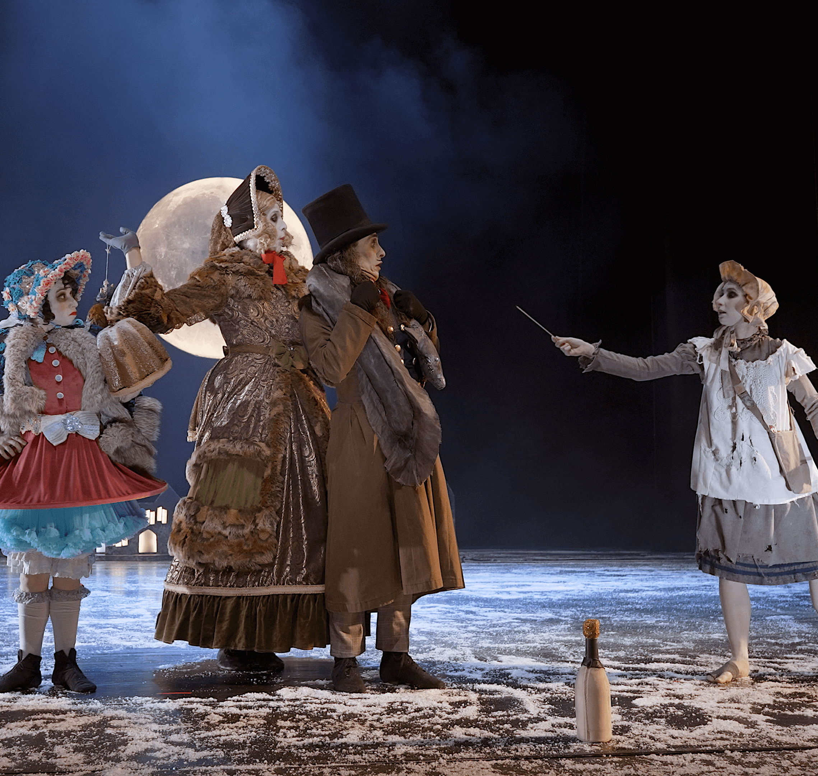
Greed
Watch the scene from
24:38 to 28:29.
In this scene, the Donnarumma family are preparing to celebrate Christmas and singing about all the luxurious foods they will eat. The little match girl desperately tries to sell them one of her matches. Each time they ignore her or shoo her away.

Slide 6
Community
School
Environment
Home

Slide 7
Examples of greed in society
Sector
Cruelty
Kindness
School
Community
Home
Environment

