Slide 1
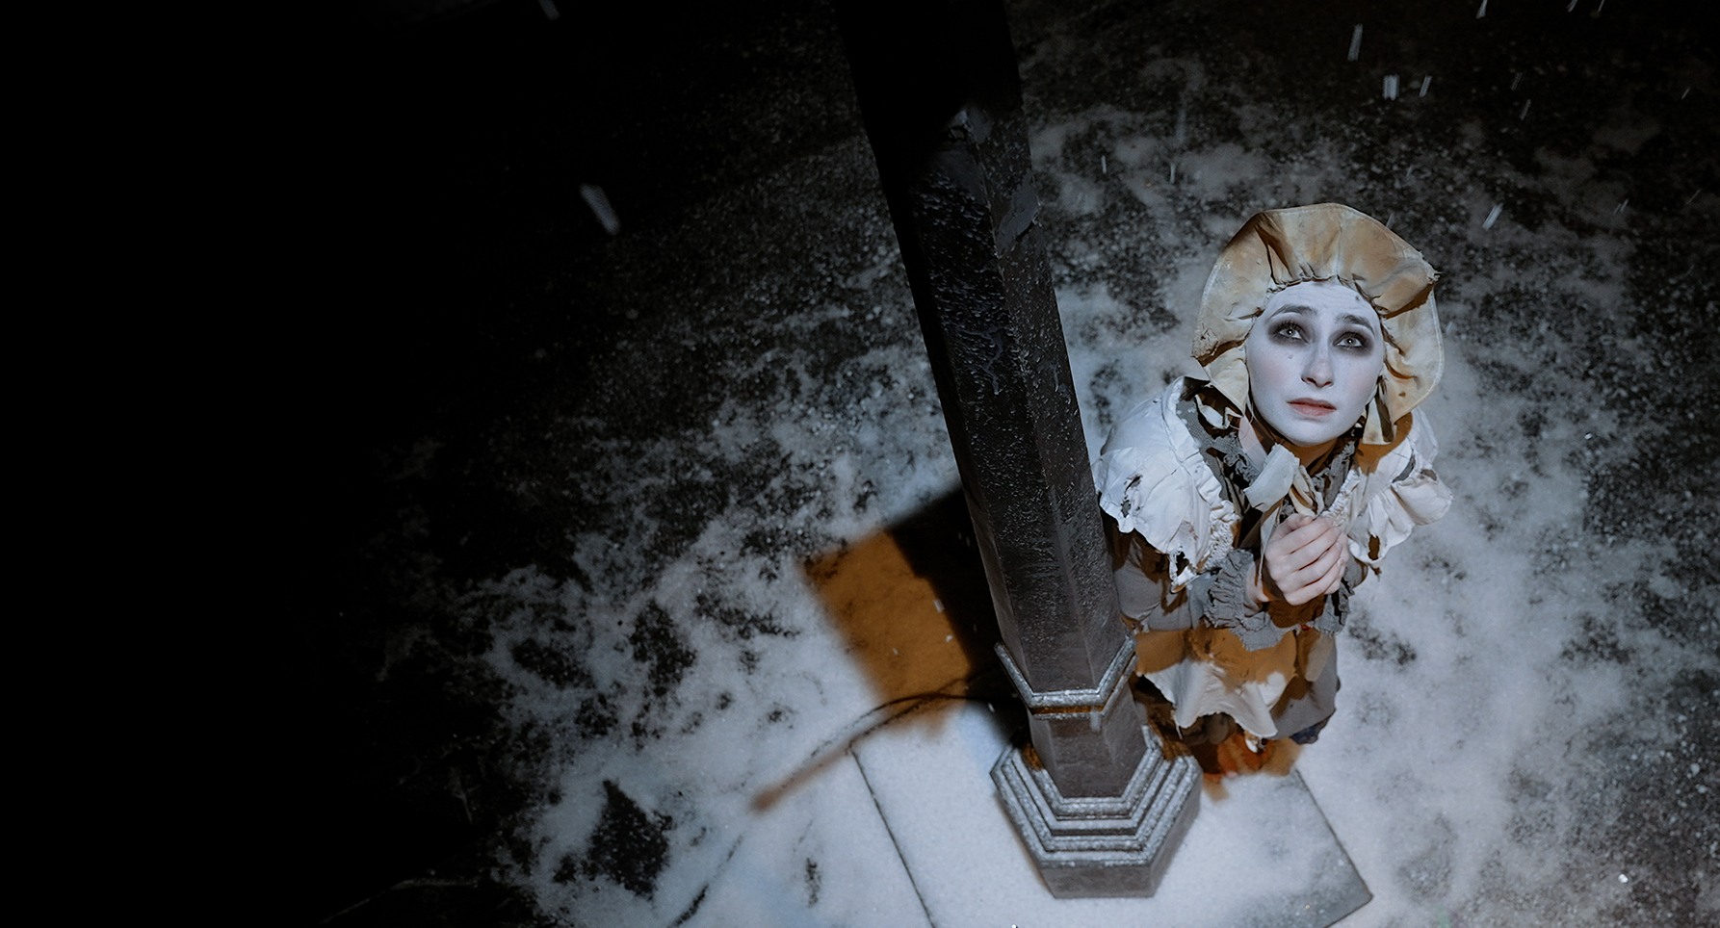
Pre-delivery lesson
Lesson Objectives
To watch and analyse The Little Match Girl
To be able to compare a production with a novel

Slide 2
A snowy stage sets the scene for an icy cold Christmas eve, where the little match girl paces the emptying streets, desperately trying to sell her matches.
Along her journey she encounters kindness and cruelty in a story about family, friendship and hope.
The traditional tale is brought to life with music, dance and some unusual instruments – look out for the theremin!
There’s also a cast of colourful characters, including the greedy Donnarumma family devouring their Christmas feast, a singing grandmother called Nonna Luna and even a dancing astronaut.
Based on Hans Christian Andersen’s classic story, this production was created for the stage and has been made into a delightful film for everyone to enjoy.
With a powerful message at its heart, The Little Match Girl reminds us
of the importance of kindness and to consider those less fortunate
than ourselves. ‘Tis the season of goodwill to all!

Slide 3
Production elements to watch out for: | Key moments of the story to watch out for:

Slide 4
A show review highlights what features of the show the audience may enjoy the most. It reflects on the show’s performance and production elements, revealing the strengths and weaknesses of the performance.
Often newspapers will send a journalist to review a show to encourage the local community to watch that production at their local theatre.
Clue
What is a journalist? A person who writes news for a media source such as a magazine, newspaper, website or television broadcast.

Slide 5
Different in the novel
Different in the production
Similarities between the novel and the production

