Slide 1
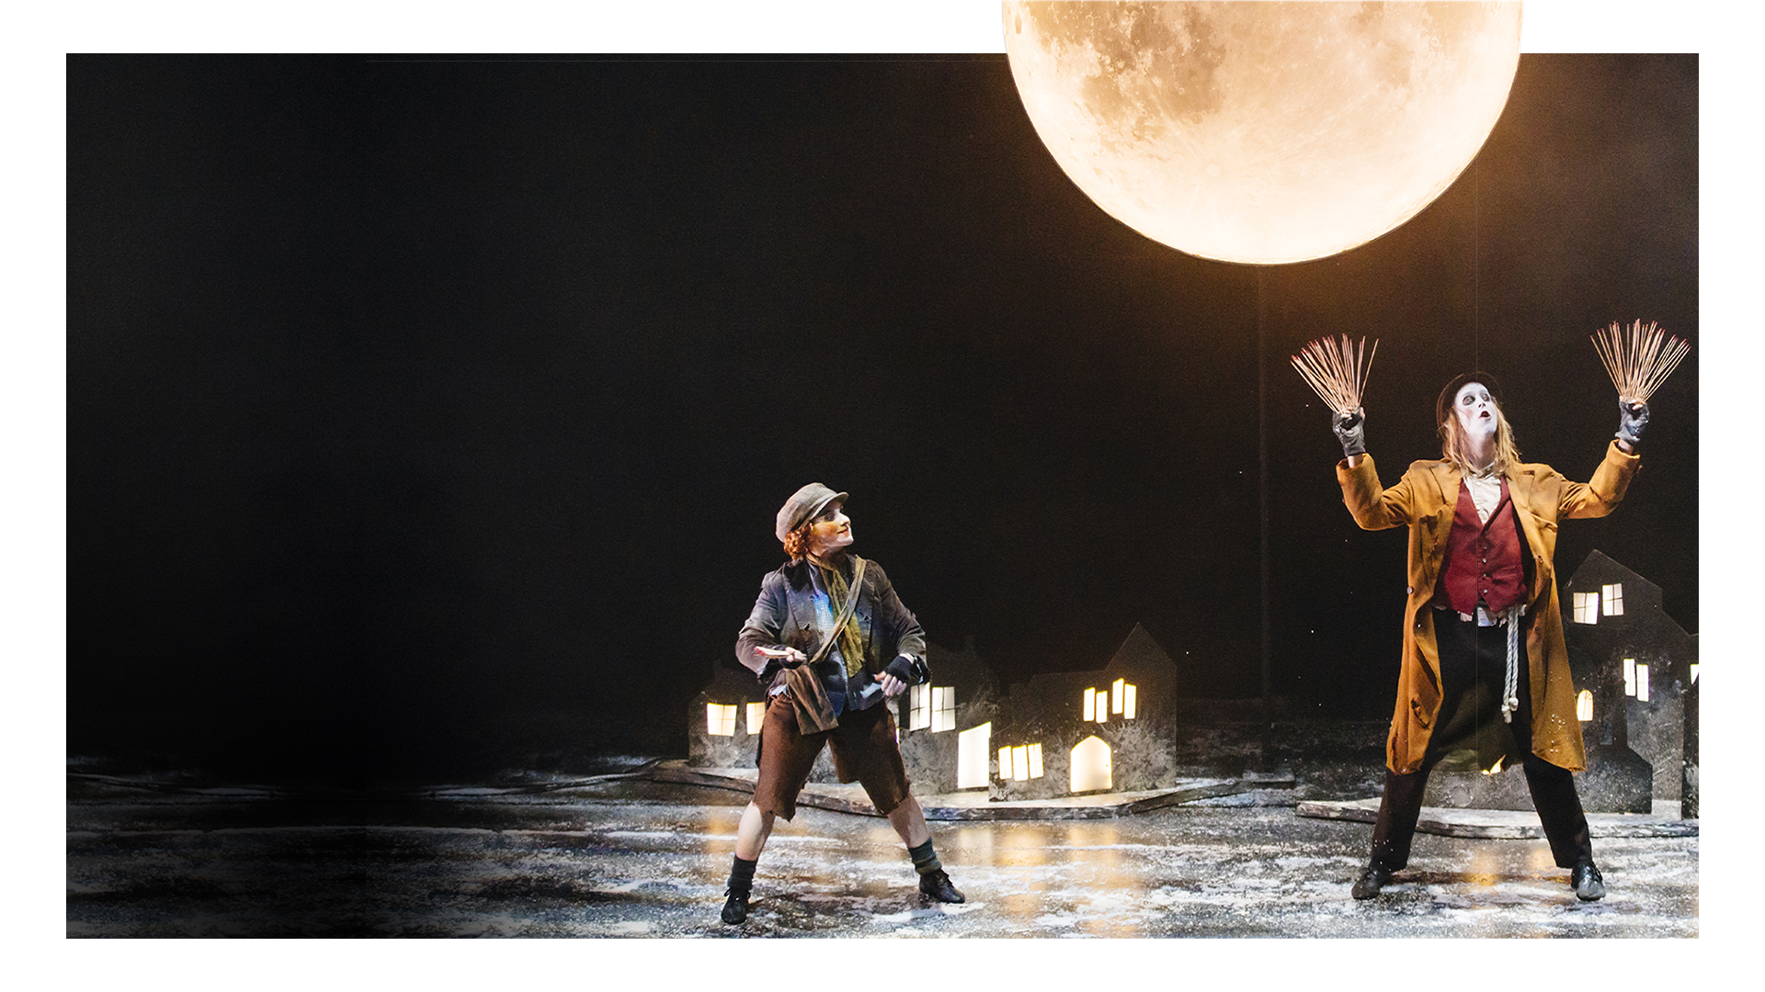
History Focus
Lesson Objectives
To understand the history of a match-seller during the Victorian era.

Slide 2
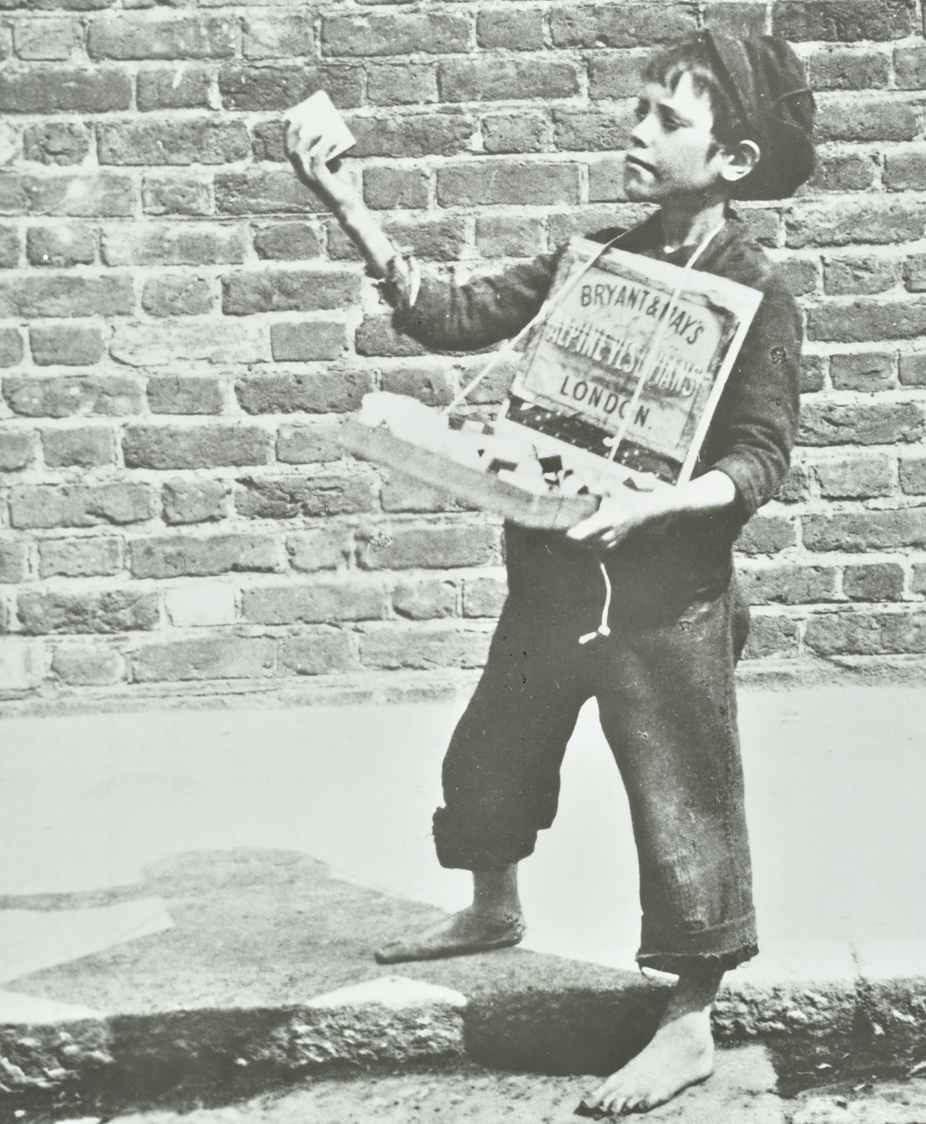

Slide 3
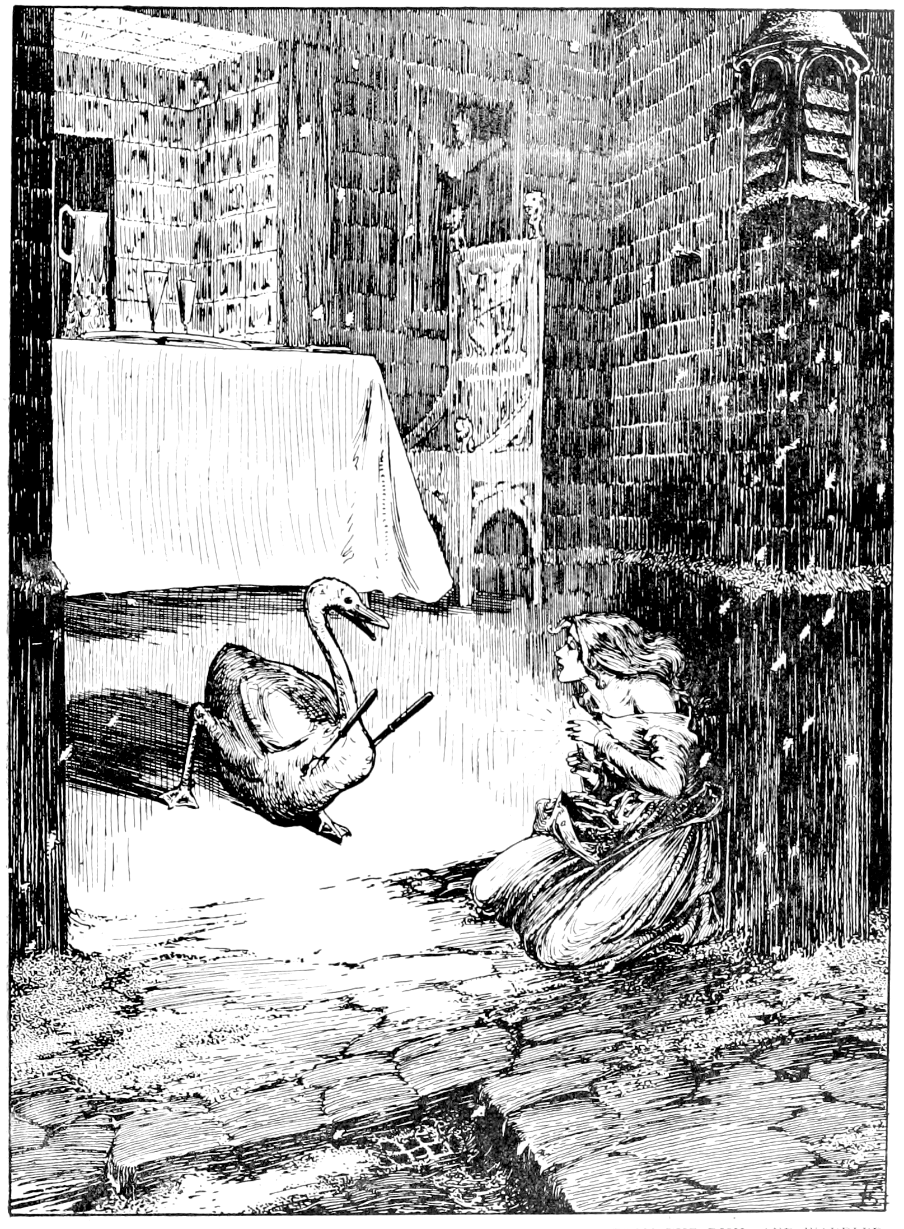
The Little Match Girl is a famous fairytale by Hans Christian Andersen.
It tells the story of a young match seller, struggling to sell her matches and stay alive in the freezing cold.
She imagines a better life.
Illustration of The Little Match Girl by Helen Stratton, 1899

Slide 4
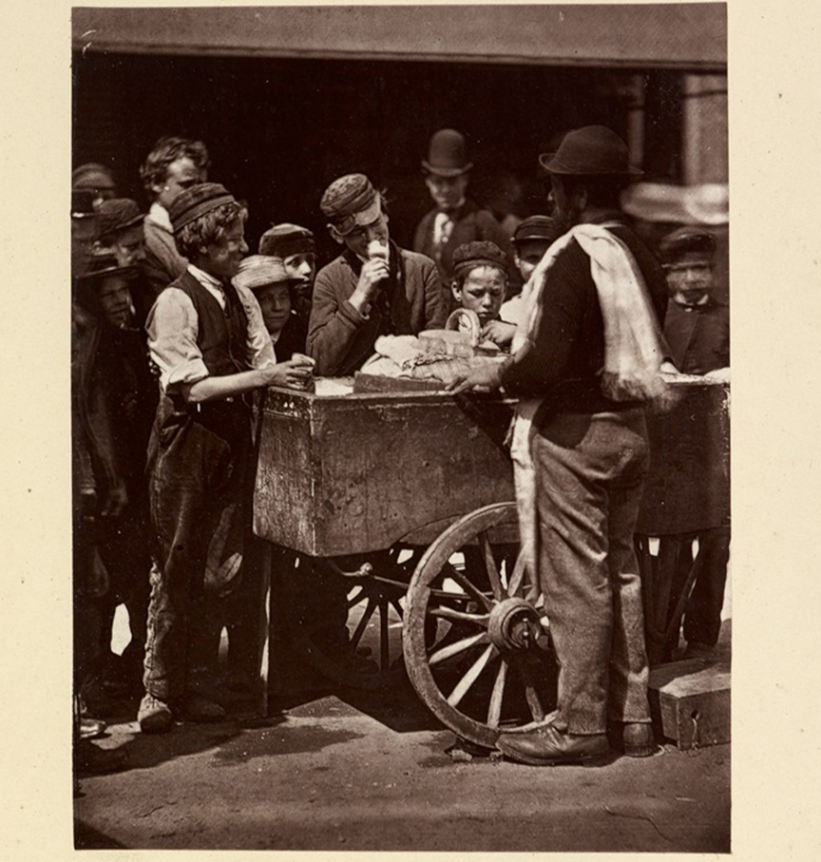
It was common in Victorian times for children to work in the labour trade, found on the streets selling goods such as matches.
They would sing songs known as cries to attract people into buying their goods.
Poor conditions meant match-sellers often acted as if they were selling matches when really, they had run out and their boxes and baskets were empty.
Labour laws – laws for the rights of the workers
State regulations – the laws and rules of that place
Industrialisation – the large-scale development of an industry or trade in a country such as shoe making or textiles
Photograph of a street-seller selling ‘half-penny ices’ by John Thomson, 1876-77

Slide 5
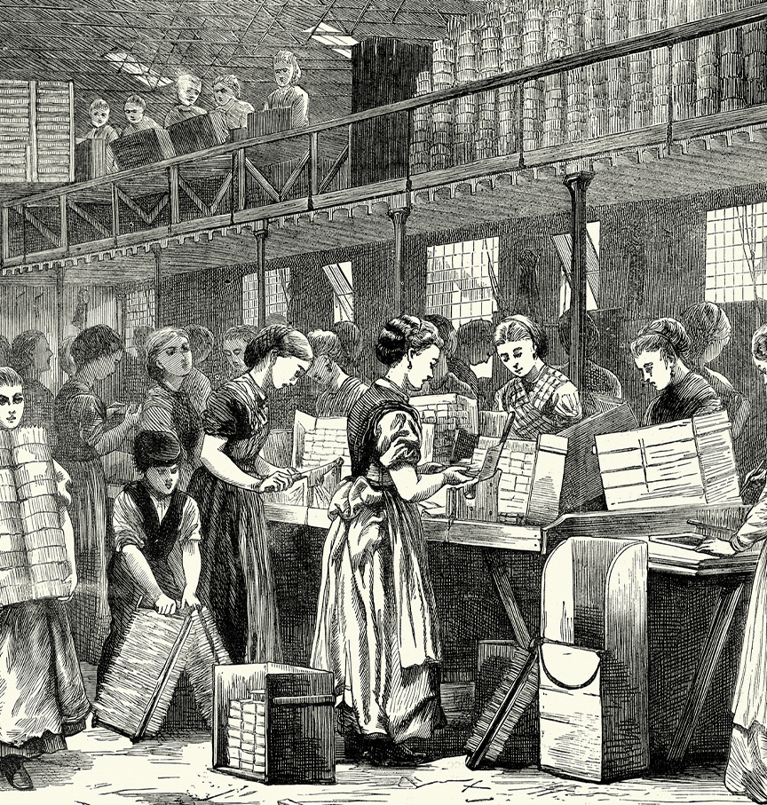
Sellers would make the matches themselves using small flints of wood and dip them in brimstone before melting.
Then science progressed and matches known as lucifers were made and could be lit by drawing the match along sandpaper. They could be made quickly in factories.
Then came inventions such as a pistol tinder box which cost very little and were easy to use.
Brimstone – a chemical sulphur
Dead of night – the darkest part of the evening
Daily bread – the food or money that someone needs to stay alive each day
Vintage engraving of young woman and children working in a match making factory in the East End of London, The Graphic, 1871

