Slide 1
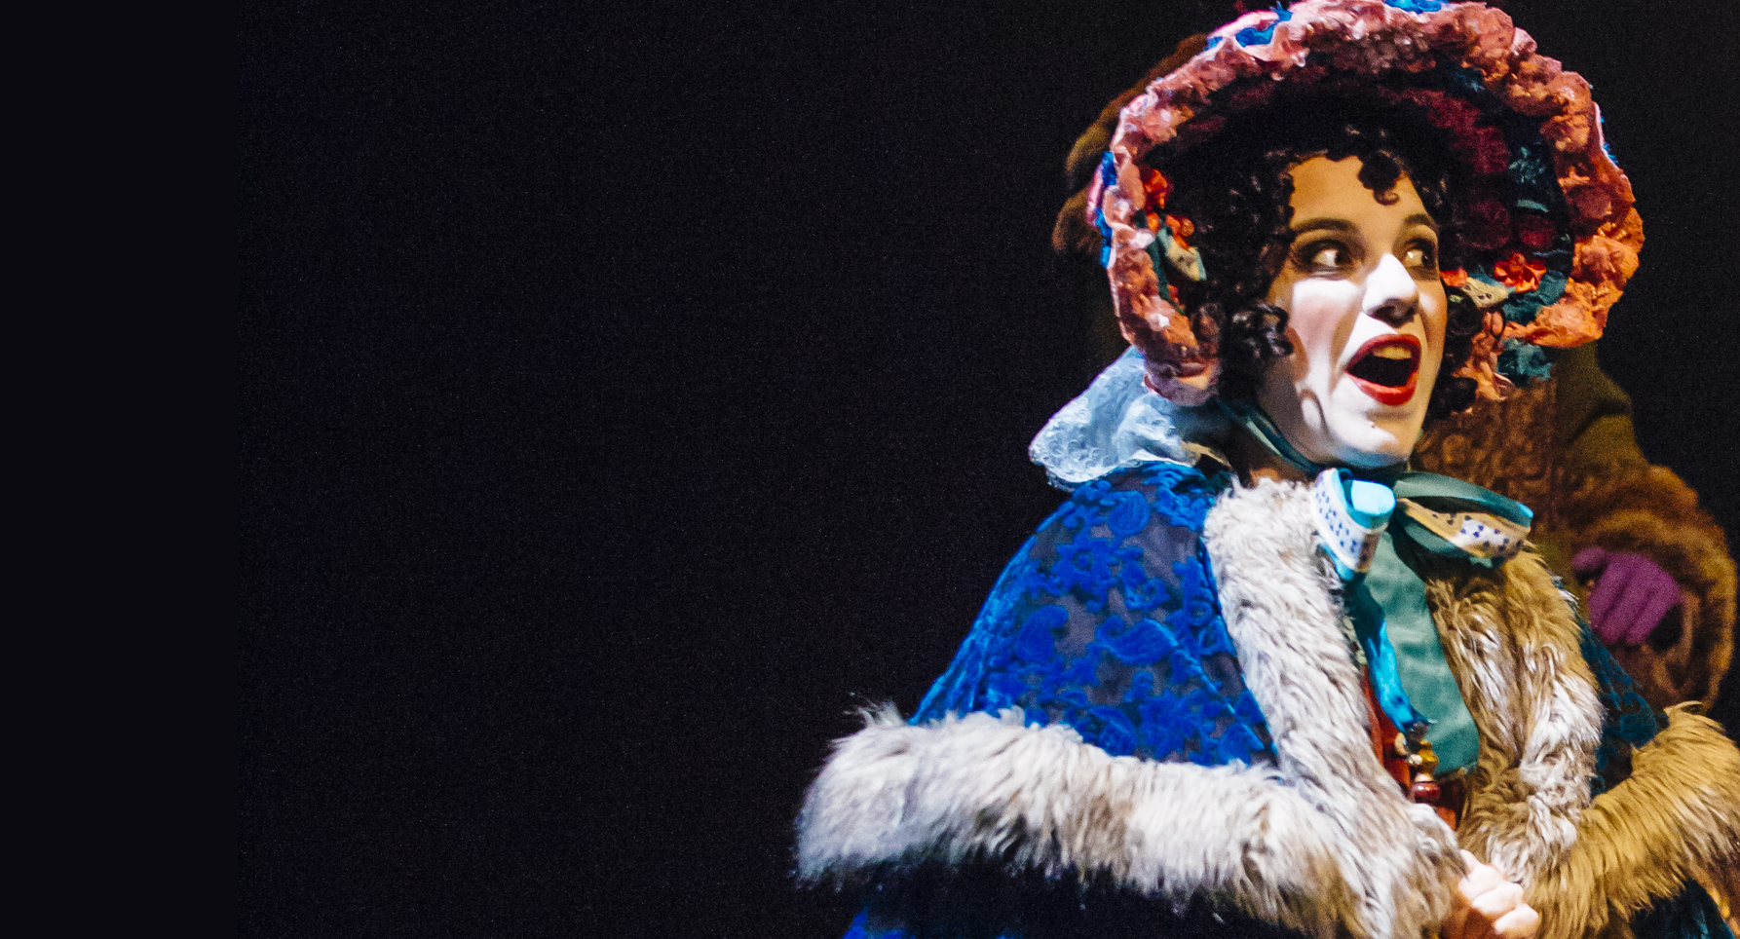
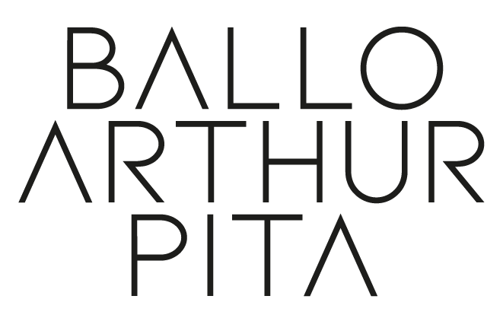
Design & Technology
Focus
Lesson Objectives
To be able to design a Victorian bonnet or hat.

Slide 2
