Slide 1
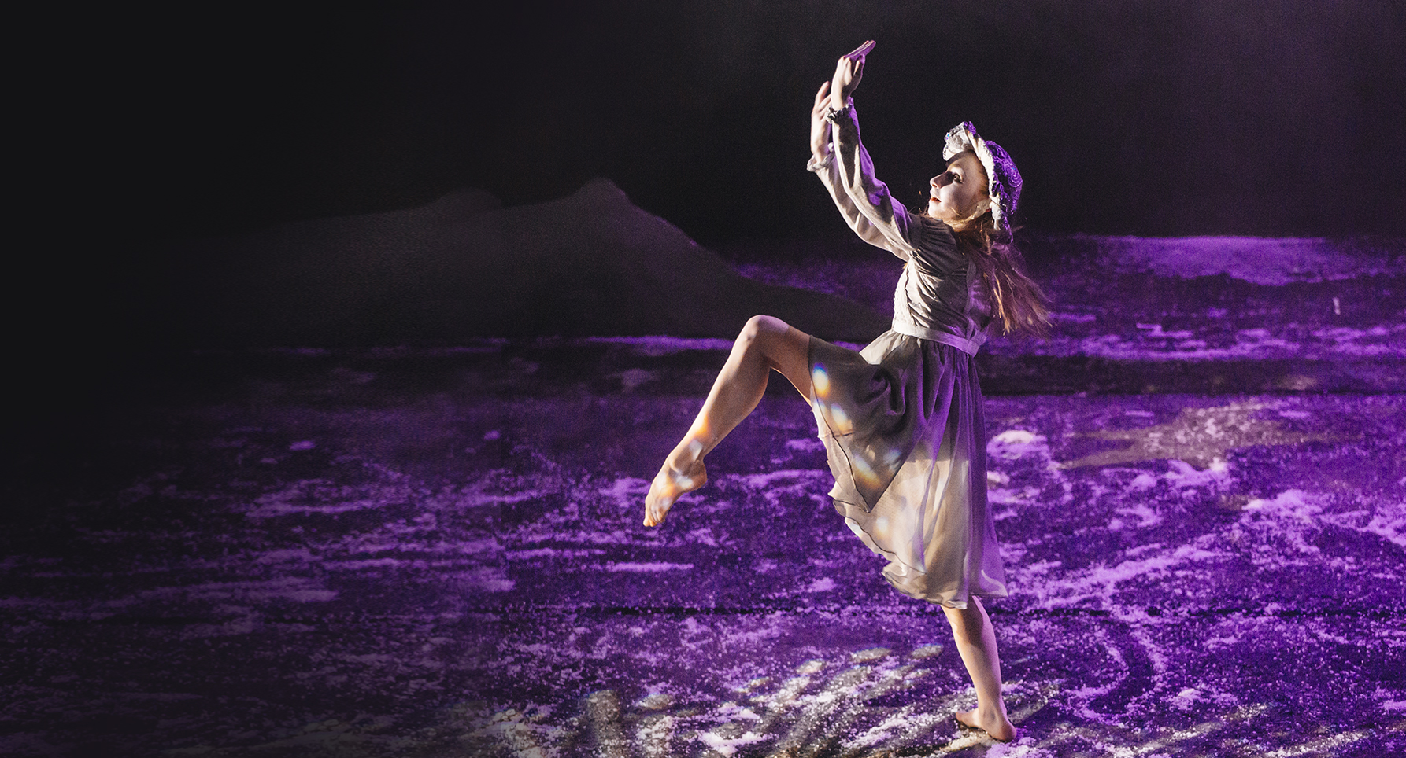
Dance Focus
Lesson Objectives
To learn a segment of the dance from the show The Little Match Girl
To be able to develop this into a performance using key dance skills

Slide 2
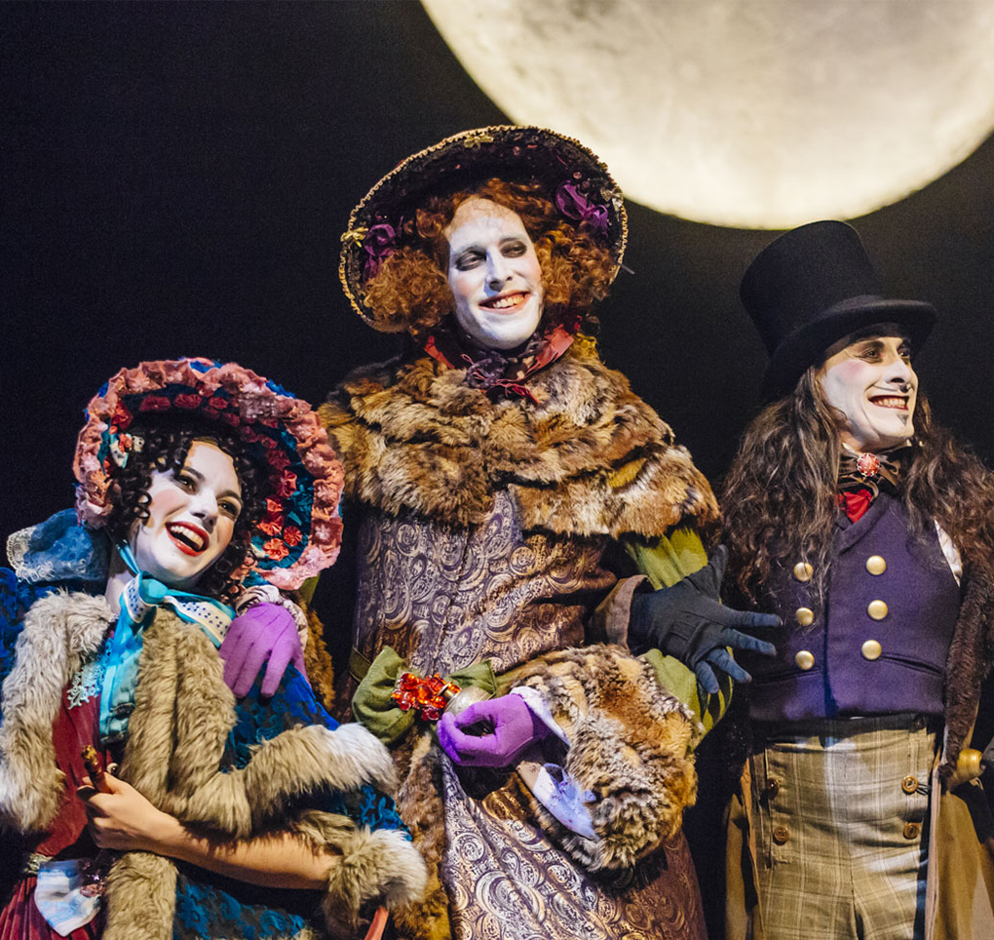
Celebration of Christmas Scene Synopsis:
In this scene, we are introduced to the Donnarumma family. They are Fulvio (right), Angelica Maria (left) and Clementina (centre). They are excited to celebrate Christmas and sing a song with the lyrics ‘Buon Natale’ repeated throughout, which means ‘Merry Christmas’ in Italian. The music and dancing is joyful.

Slide 3
Develop your dance using one or more of the action skills:
Gesture: A movement that expresses an idea or feeling. Example – a clap or point.
A turn: Moving the body in a circular motion. Example - moving 180 degrees to change direction.
A jump: Going up into the air by pushing off a surface. Example – a tuck jump.
Idea
A family putting up decorations for a celebration

Slide 4
Develop your dance using one or more of the relationship skills:
Contact: A point of connection between two or more dancers such as a hand, arm or foot.
Unison: Dancers performing the same movement at the same time.
Mirroring: To do the same movement at exactly the same time facing one another as if the other dancer is their reflection in a mirror.
Idea
A family celebration with the exchange of gifts

Slide 5
Develop your dance using one or more of the space skills:
Levels: The body’s distance to the ground: low, medium or high. Examples – a floor slide or a jump.
Direct or Indirect Travelling: Moving from one place to another directly or indirectly. Examples – directly travelling in a straight line or indirectly zig-zagging across the space.
Patterns: Tracing a design in the air, floor or space using the body. Examples – creating a wave movement from the right arm to the left arm or tracing circle on the floor with the right foot.
Idea
A family coming together for a celebratory feast

Slide 6
Conclude your dance using one or more of the dynamic skills:
Fast: Moving quickly to the music. Example - travelling with a sense of urgency like the hare.
Slow: Moving gradually to the music. Example – moving across the room at a gradual pace like the tortoise.
Idea
The excitement of a celebration

