Slide 1
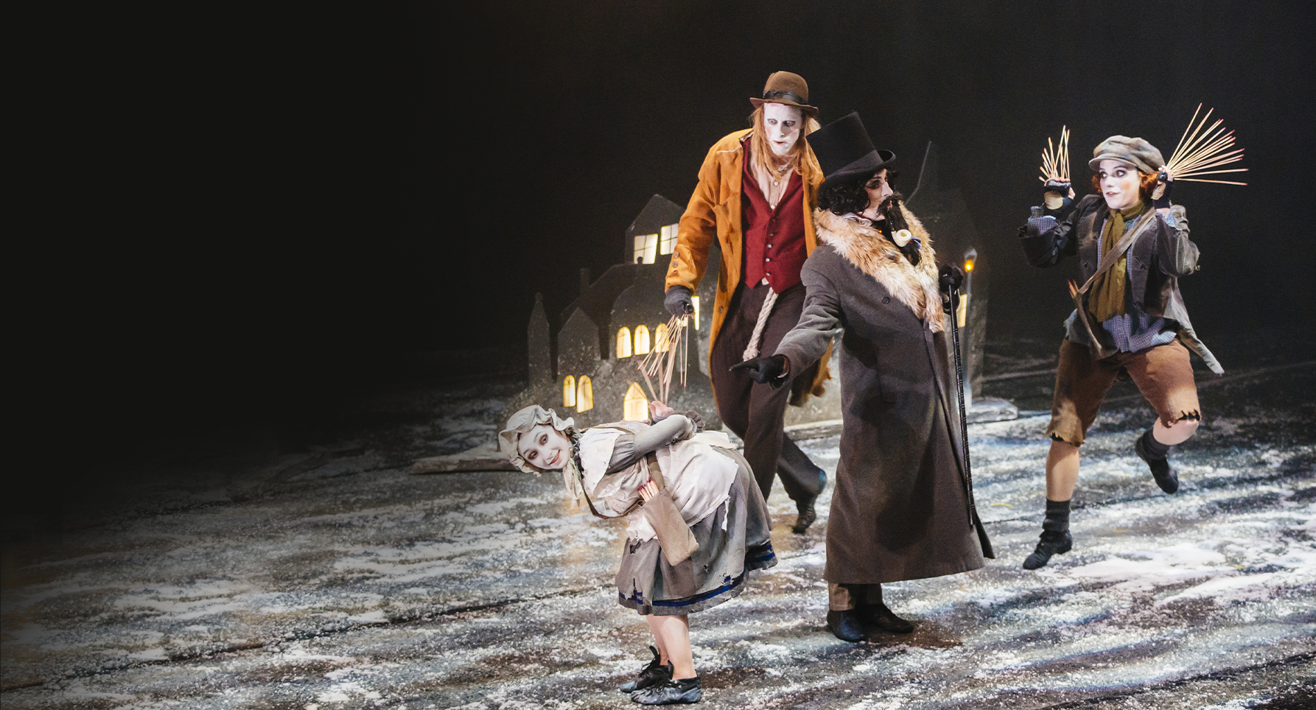



Art Focus
Lesson Objectives
To create an illustration of a scene.

Slide 2
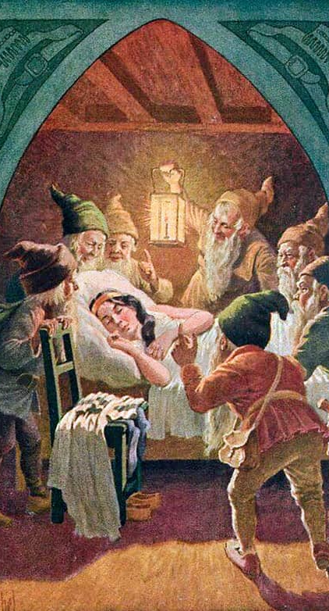
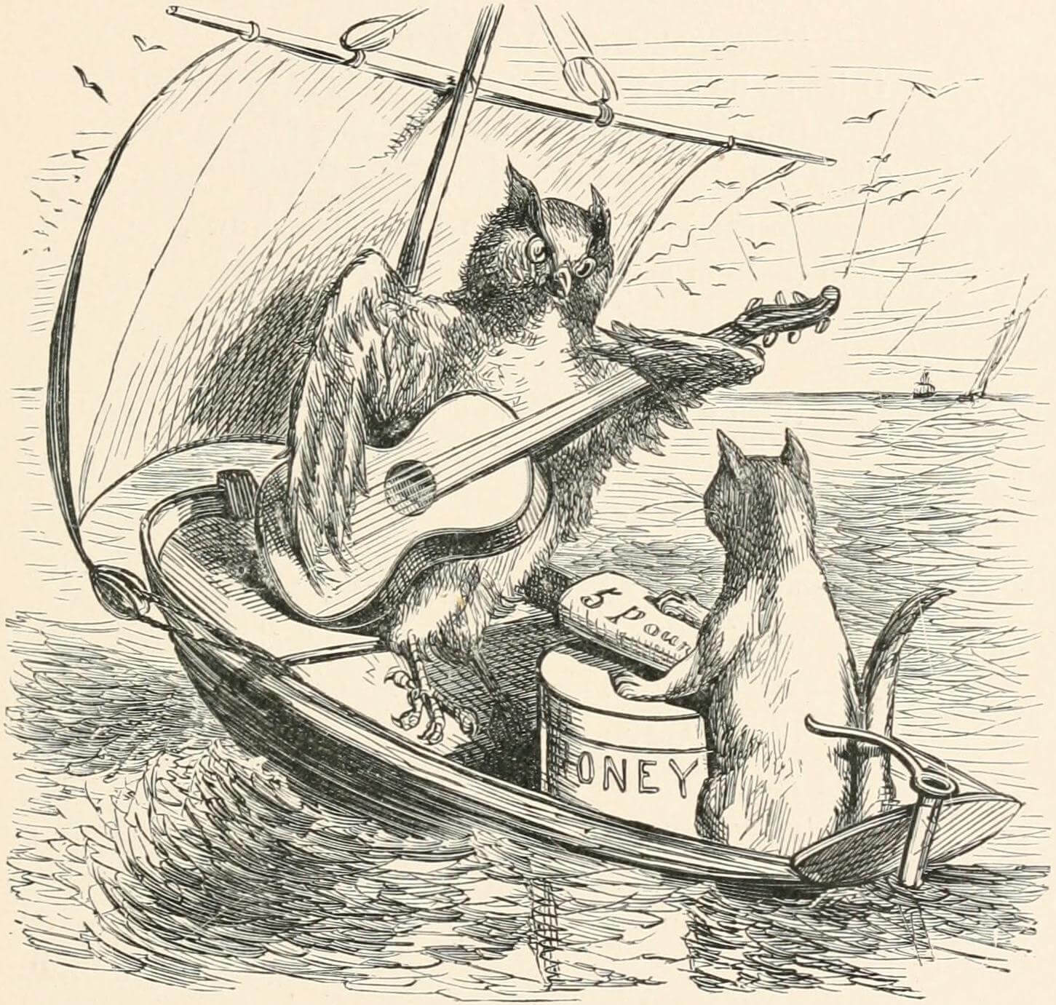
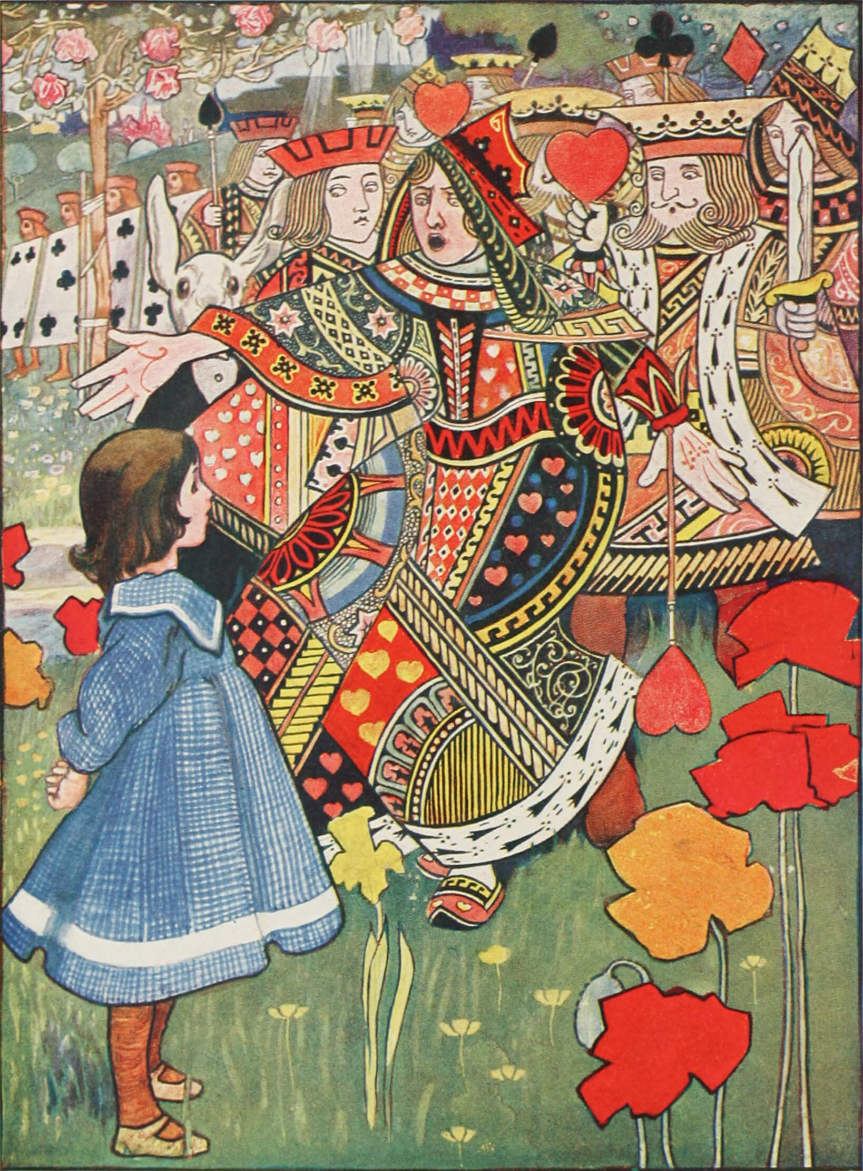
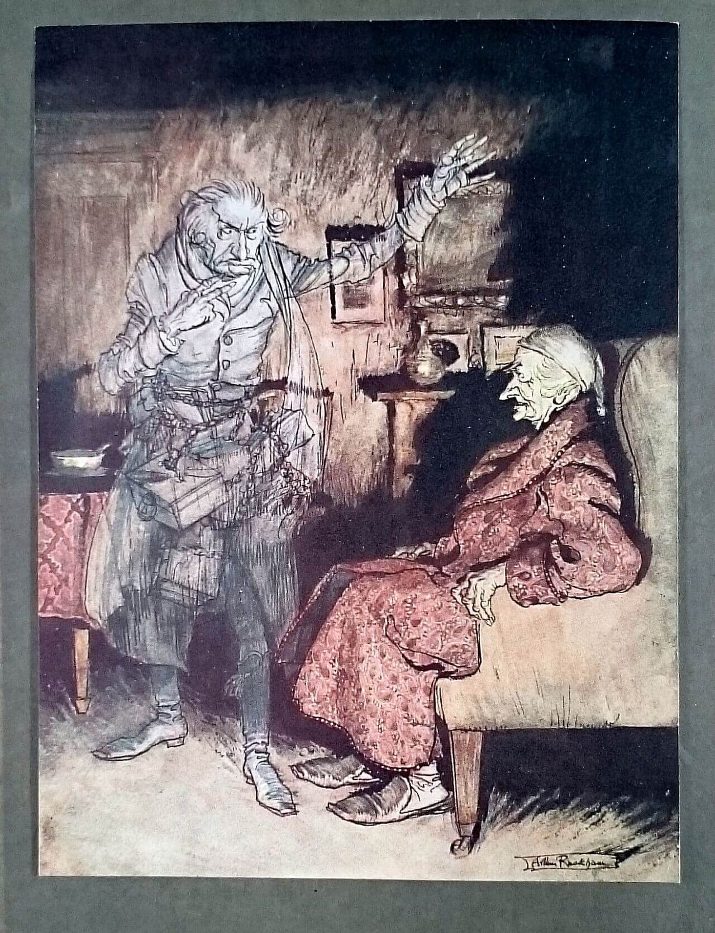
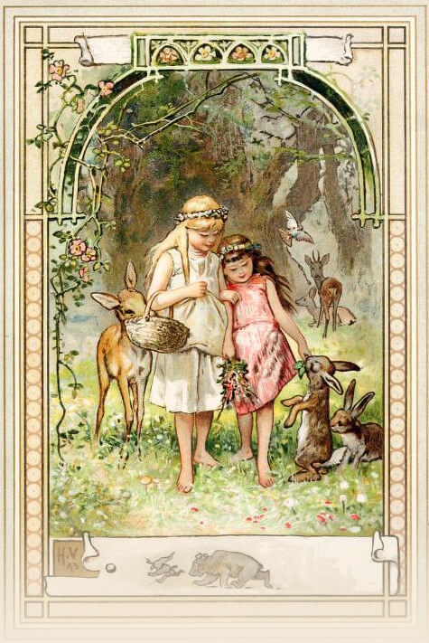
Snow White by Otto Kubel
The Owl and The Pussycat
Illustrator unknown
A Christmas Carol
by Arthur Rackham
Alice’s Adventures in Wonderland by Charles Robinson
Snow White and
Rose Red by
Herman Vogel

Slide 3
